Slide 1
Week 2 Tutorial
COMP10001 – Foundations of Computing
Semester 1, 2025
Clement Chau

Slide 2
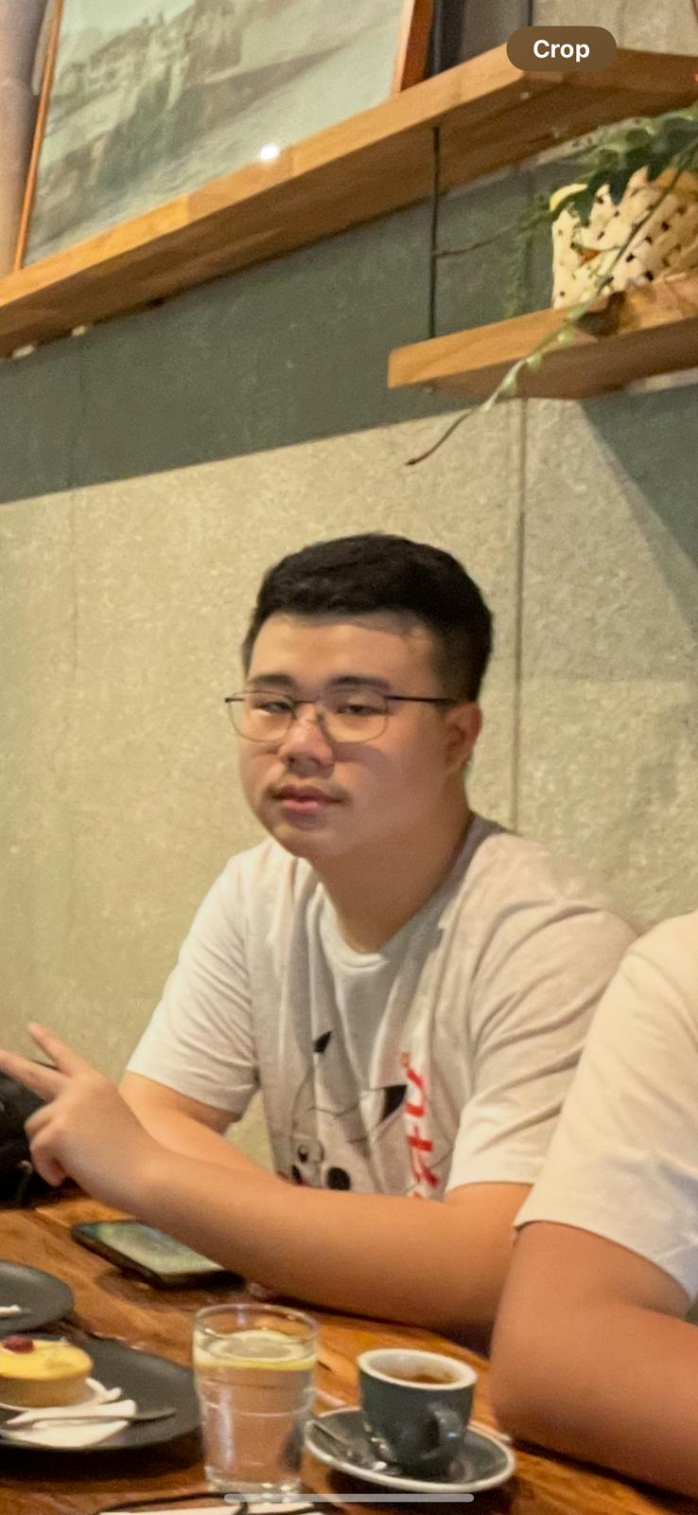
Get to know myself
Clement Chau (he/him)
3rd Year BSc, majoring in Computing and Software Systems
Was part of the 2023S1 Cohort of COMP10001 (You guys are 2025S1 cohort!)
Avid Esports enthusiast. If I'm not working nor studying, I'm on my computer watching ongoing games or playing games with friends.
Head of Technical for MUE (Melbourne University Esports). VAL/CS2/Rivals/League/MLBB etc etc! Part of the university's val team last sem =)

Slide 3
Get to know yourself
Name
Year, Semester, Course
Choose one (or all) of:
Fun fact about yourself
Your hobbies/Interests (What do you do in your free time?)
Choose one (or all) of:
Favorite Game
Favorite Movie
Favorite Place you've visited outside of your city

Slide 4
Where can COMP10001 take me?
Foundations of Computing introductory video
Software engineer
Building websites, apps
Data scientist/analyst
Amazon recommendations, Google search engine
AI/ML Engineer
Chatbots such as ChatGPT, DeepSeek
Game Development
Other types of engineering
Electrical Engineering, Robotics
And so much more...

Slide 5
Programming is a very transferrable skill to any field and any career

Slide 6
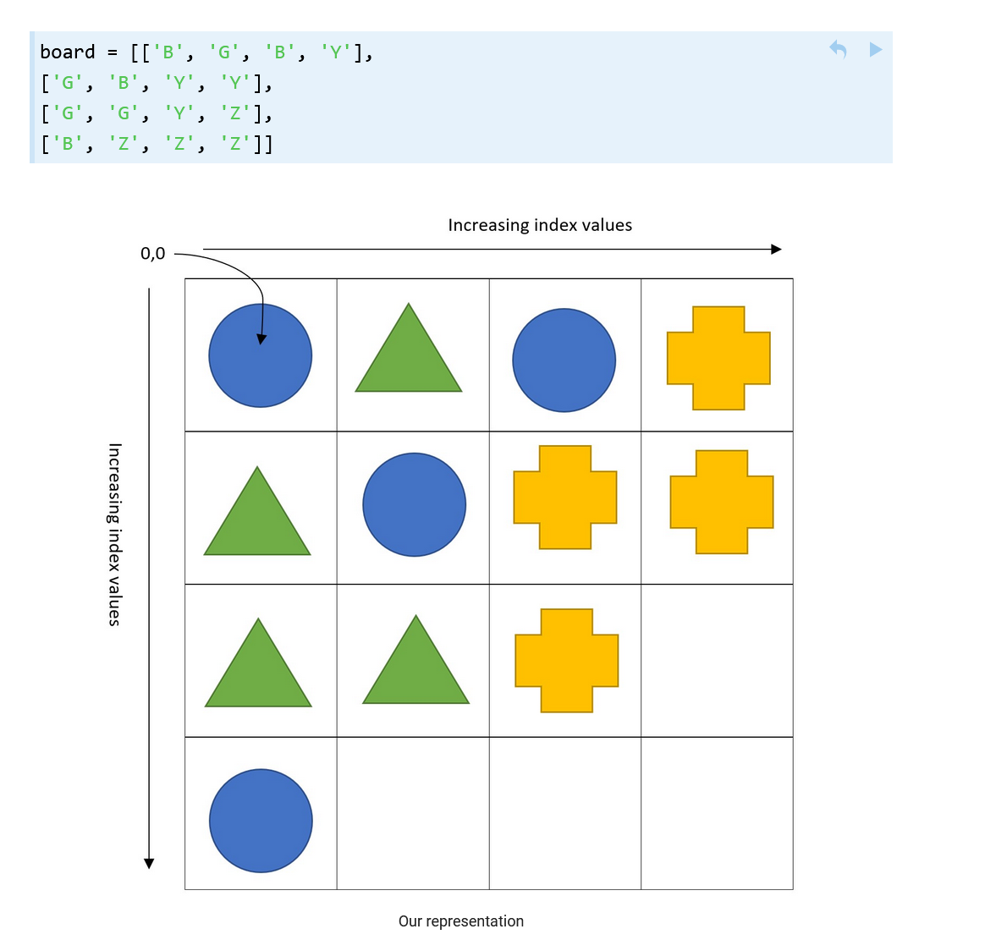
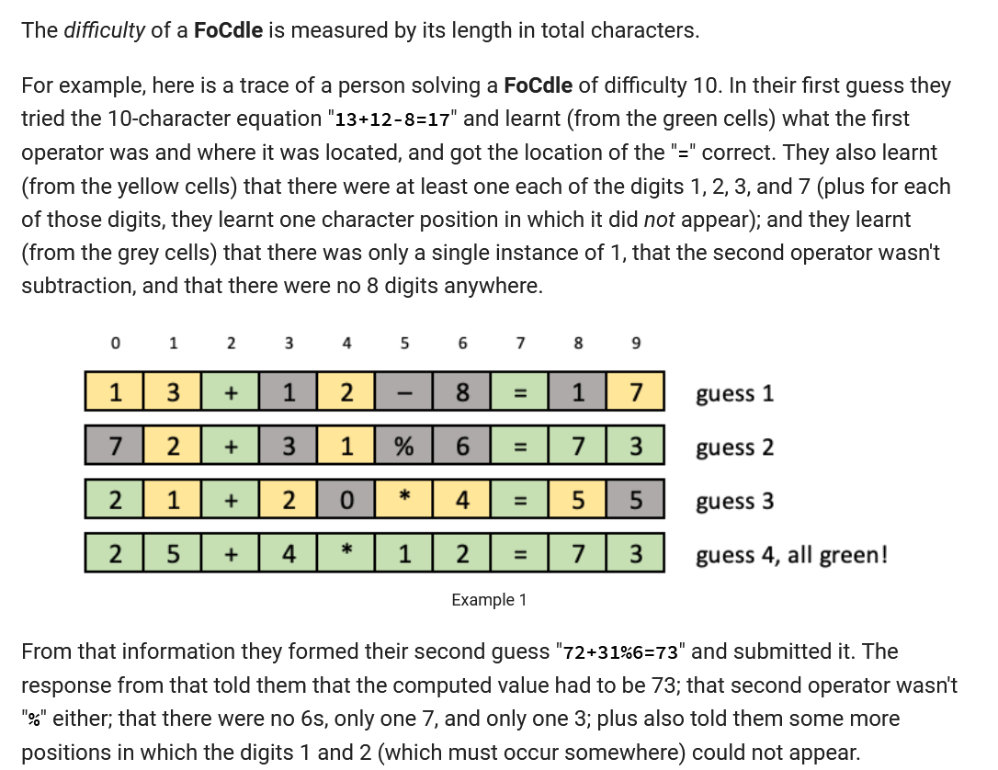
2 years ago,
Project 1 – Matching game
Project 2 – FoCdle

Slide 7
Academic Integrity
Where NOT to get help
Online
Forums, External Tutor
You can post it on Ed, but make it PRIVATE!
ChatGPT, DeepSeek, etc
'Friends'
In the past we have given penalties such as:
Zero (0) for the assignment.
Zero (0) for the subject.
Termination of enrollment from the University.
IMPORTANT: If in doubt regarding what's allowed and what's not, ASK THE TEACHING STAFF.

Slide 8
Getting Help
Tutorials (2nd hour)
First Year Centre in Level 3 Melbourne Connect
Opens 9am to 5pm every day (bring your student card!!!)
COMP10001 tutors will be there at 12pm to 2pm
I will be there on Mondays and Wednesdays
Ed Discussion forums
Revisiting lectures and workshop materials in Canvas
Consolidation lectures every other Friday
PASS (Peer Assisted Study Sessions)
clementchau@unimelb.edu.au
clement.chau@unimelb.edu.au

Slide 9

Bingo time!

Slide 10
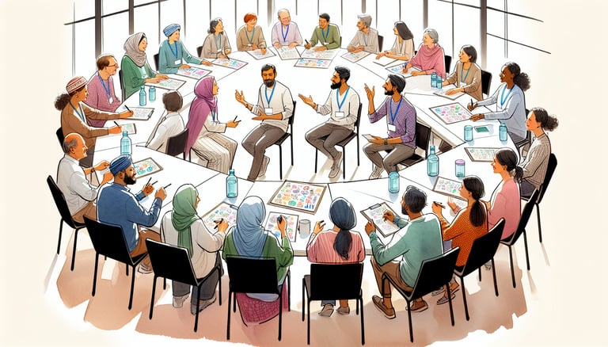
Find 3 things that your table has in common

Slide 11
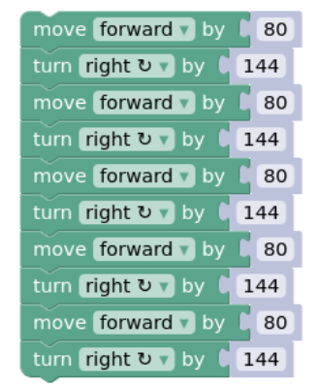

Blocky Turtle!

Slide 12
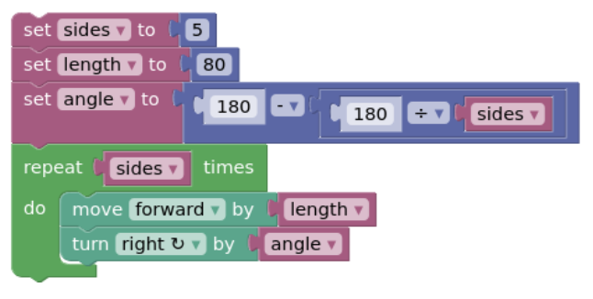
Can we do this more effectively?

Slide 13
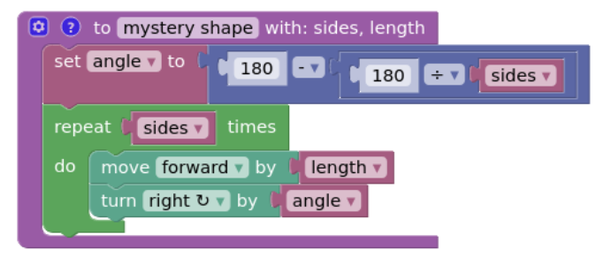
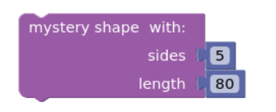
Can we make it even better?

Slide 14
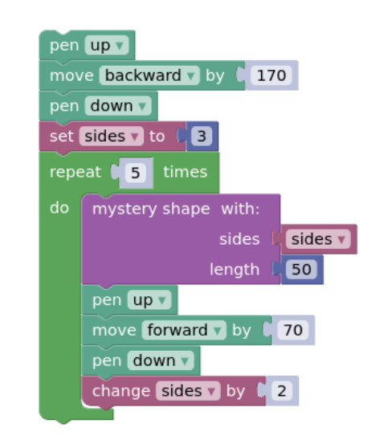

Challenge!
What does this draw?

Slide 15

This is a tricky one!

Slide 16
Independent work
Do worksheets 1 and 2 on Ed
Remember that Ed worksheets are assessed and contributes to 10% of your total score!
Raise your hand if you have any questions!

